Slide 1
Obrambeni sustavi i tehnologije
Seminarski rad: Tema T12
Ke, L., Zhang, G., He, J., Li, Y., Li, Y., Liu, X., & Fang, P. (2023). Pilot selection in the era of virtual reality: Algorithms for accurate and interpretable machine learning models. Aerospace, 10(5), 394 Franko Krajina
Boris Boronjek
Rene Županić
siječanj 2025.
Notes:
TBD Staviti slike itd.

Slide 2
Ke, L., Zhang, G., He, J., Li, Y., Li, Y., Liu, X., & Fang, P. (2023). Pilot selection in the era of virtual reality: Algorithms for accurate and interpretable machine learning models. Aerospace, 10(5), 394 University of Zagreb, Faculty of Electrical Engineering and Computing, Croatia
Autor obrade članka:
Franko Krajina
siječanj 2025.
Notes:
TBD Staviti slike itd.

Slide 3
Pilot selection in the era of virtual reality: Algorithms for accurate and interpretable machine learning models
Abstract
Combining machine learning and virtual reality to identify suitable prospective pilots cost-effectively.
23 pilots from China Eastern Airlines and 23 novices from Tsinghua University participated in the study.
SVM with MIC feature selection achieved the highest accuracy (0.93), AUC (0.96), and F1-score (0.93).
MIC feature selection effectively captures nonlinear relationships, outperforming other selection methods.
VR-based pilot selection approach can extend to astronaut training and other high-performance fields.

Slide 4
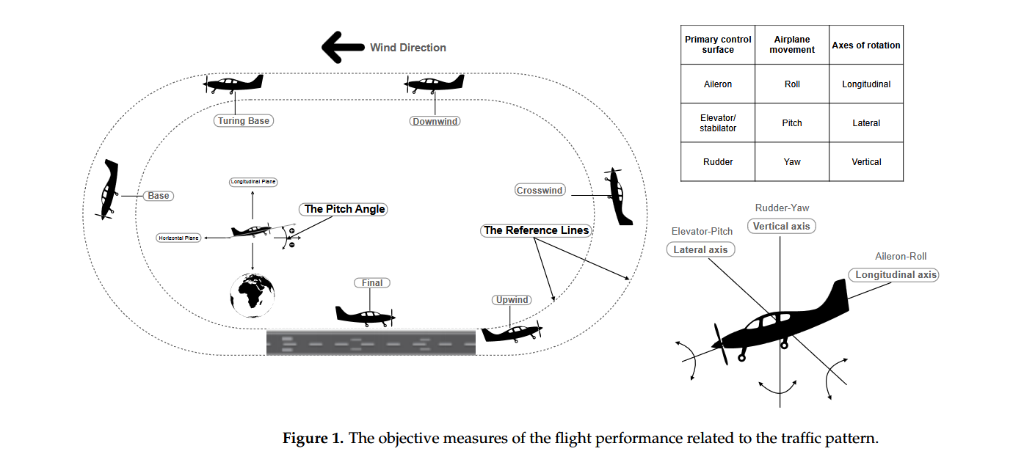
Pilot selection in the era of virtual reality: Algorithms for accurate and interpretable machine learning models
Main Information regarding Research Methods
Applied sequence of tasks for each of N=46 (23-23):

Slide 5
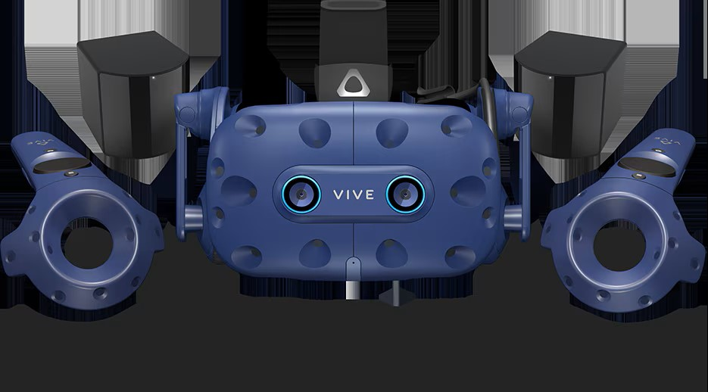
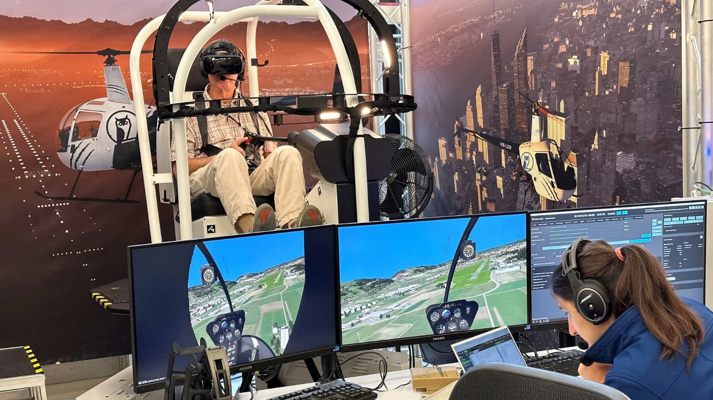
Pilot selection in the era of virtual reality: Algorithms for accurate and interpretable machine learning models
MIC (Mutual Information Coefficient) was used for feature selection
SVM (Support Vector Machine) for classification (novice – expert)
Features used:
Flight performance data (QAR – Quick Access Recorder)
Total flight time
Pitch angle before landing
Distance to the center of 2 reference lines
…
Eye movement data (EM & AOI)
AOIs (areas of interests)
Airspeed indicator, attitude indicator, etc.
Eye opening percent
Dwell time measured
…

Slide 6
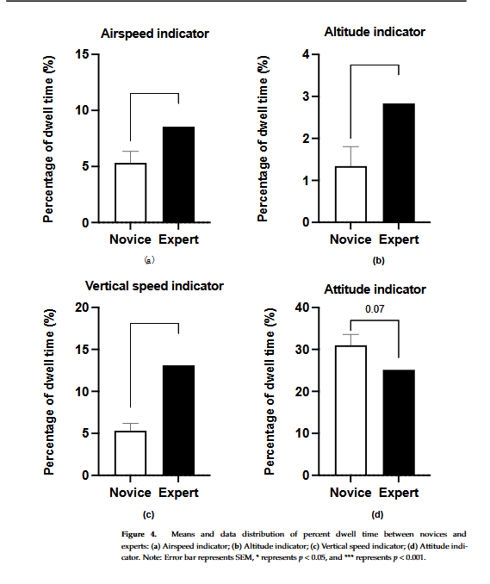
Pilot selection in the era of virtual reality: Algorithms for accurate and interpretable machine learning models
Main Research results

Slide 7
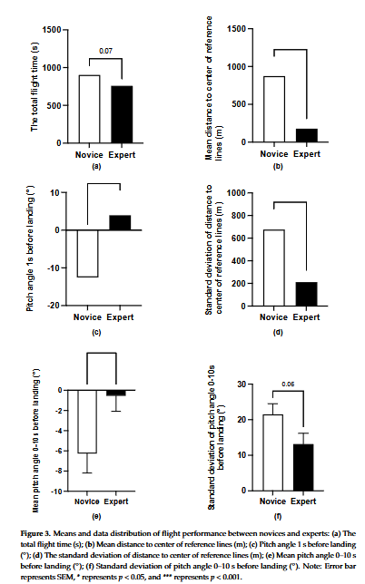
Pilot selection in the era of virtual reality: Algorithms for accurate and interpretable machine learning models
Main Research results

Slide 8
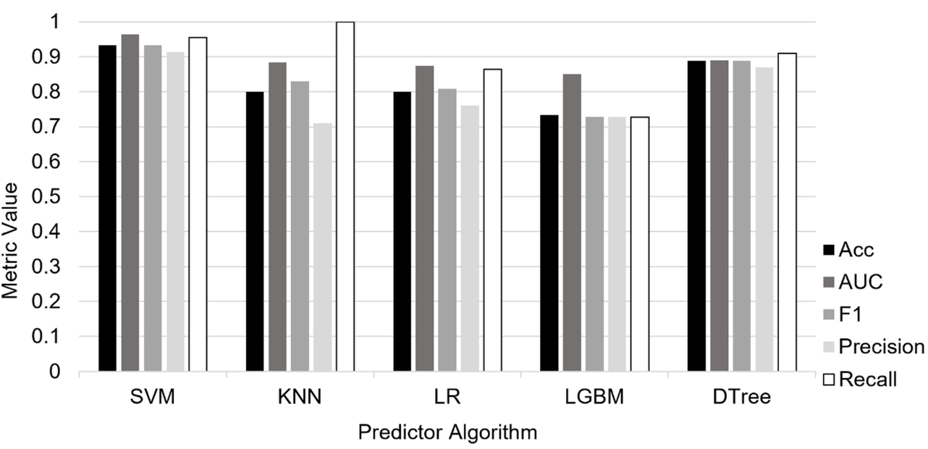
Pilot selection in the era of virtual reality: Algorithms for accurate and interpretable machine learning models
Main Research Results
The performance comparison between predictor algorithms with MIC feature selection method

Slide 9
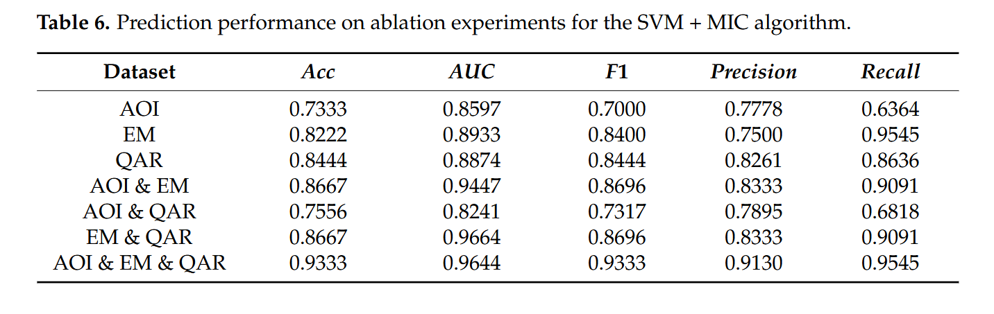
Pilot selection in the era of virtual reality: Algorithms for accurate and interpretable machine learning models
Main Research Results

Slide 10
Pilot selection in the era of virtual reality: Algorithms for accurate and interpretable machine learning models
Conclusion
The SVM + MIC algorithm achieved 93.33% accuracy, surpassing most existing models.
Virtual Reality with eye tracking enables a cost-effective, portable, and automated pilot selection process.
Beyond pilot selection, the approach has potential applications in astronaut training and other high-performance fields

Slide 11
Jubilee Prasad-Rao¹, Olivia J. Pinon Fischer², Neil C. Rowe³, Jesse R. Williams¹, Tejas G. Puranik², Dimitri N. Mavris², Michael W. Natali⁴, Mitchell J. Tindall⁴ and Beth W. Atkinson⁴ (2020). Attrition Risk and Aircraft Suitability Prediction in U.S. Navy
Pilot Training Using Machine Learning
Aerospace 2023, 10(4), 379
Institucije autora članka: ¹ Naval Postgraduate School, Monterey, CA, USA ² Georgia Institute of Technology, Atlanta, GA, USA ³ Chief of Naval Air Training, Corpus Christi, TX, USA ⁴ Naval Air Warfare Center Training Systems Division, Orlando, FL, USA
Autor obrade članka:
Rene Županić
siječanj 2025.
Notes:
TBD Staviti slike itd.

Slide 12
Attrition Risk and Aircraft Suitability Prediction in U.S. Navy Pilot Training Using Machine Learning
Abstract
The cost to train a basic qualified U.S. Navy fighter aircraft pilot is nearly USD 10 M. The training includes primary, intermediate, and advanced stages, with the advanced stage involving extensive flight training, and, thus, is very expensive as a result.
Despite the screening tests in place and early-stage attrition, 4.5% of aviators undergo attrition in this most expensive stage. Key reasons for aviator attrition include poor flight performance, voluntary withdrawals, and medical reasons. The reduction in late-stage attrition offers several financial and operational benefits to the U.S. Navy. To that end, this research leverages feature extraction and machine learning techniques on the very sparse flight test grades of student aviators to identify those with a high risk of attrition early in training.
Using about 10 years of historical U.S. Navy pilot training data, trained models accurately predicted 50% of attrition with a 4% false positive rate. Such models could help the U.S. Navy save nearly USD 20 M a year in attrition costs. In addition, machine learning models were trained to recommend a suitable training aircraft type for each student aviator. These capabilities could help better answer the need for pilots and reduce the time and cost to train them.

Slide 13
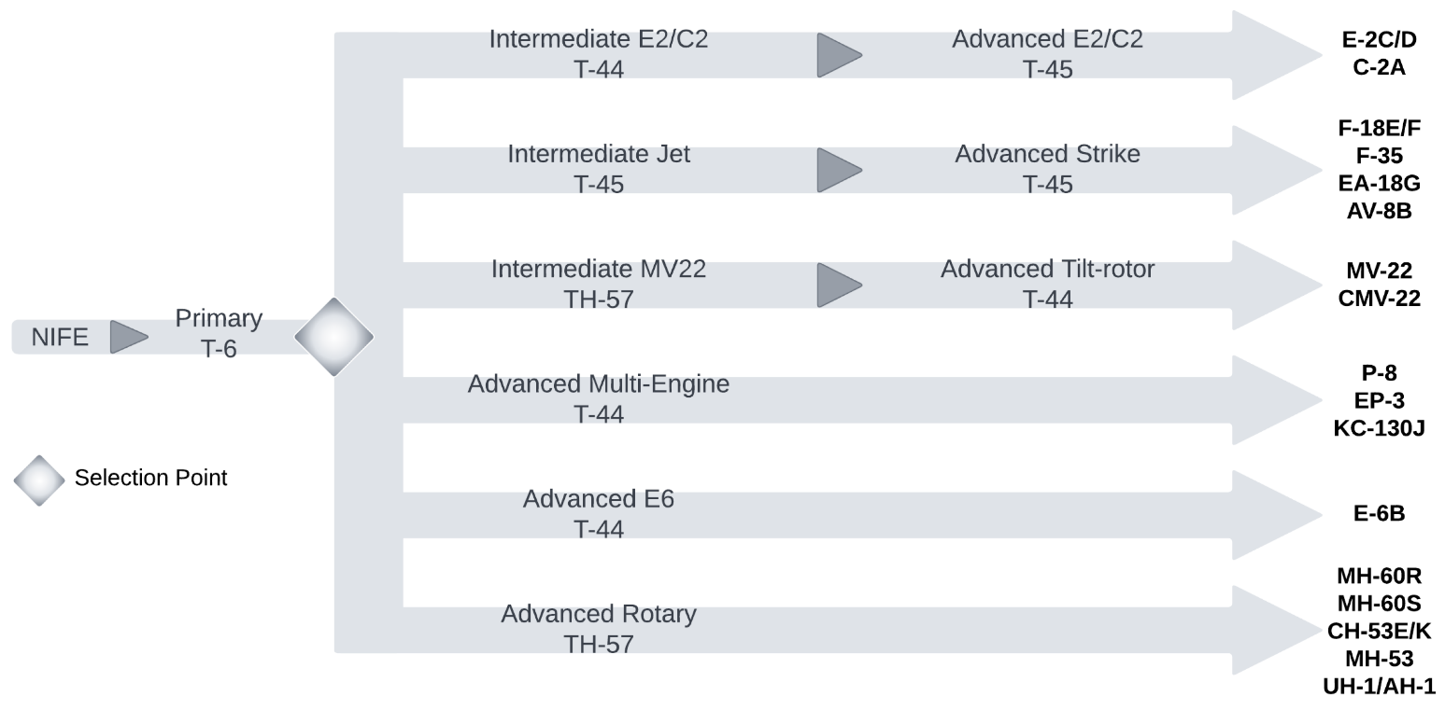
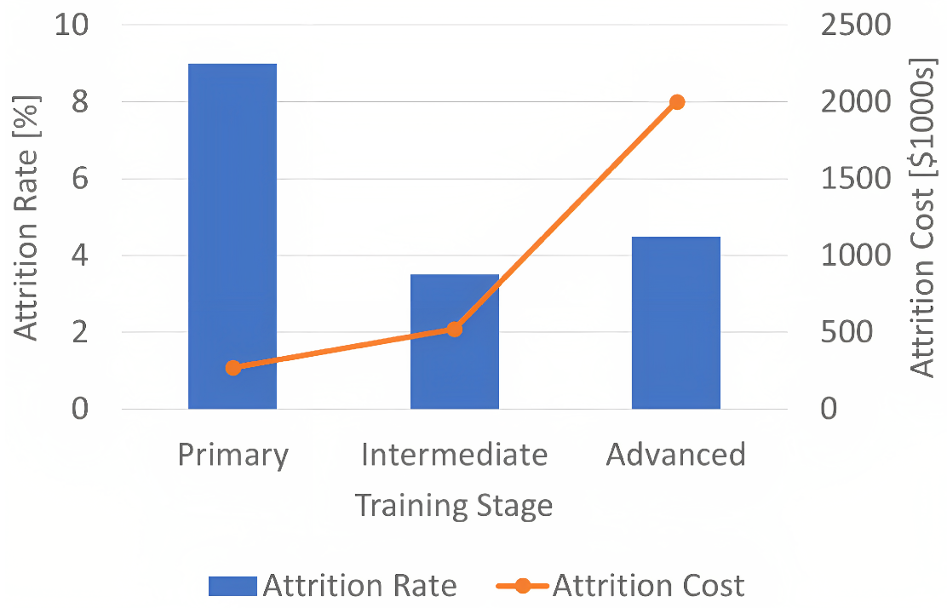
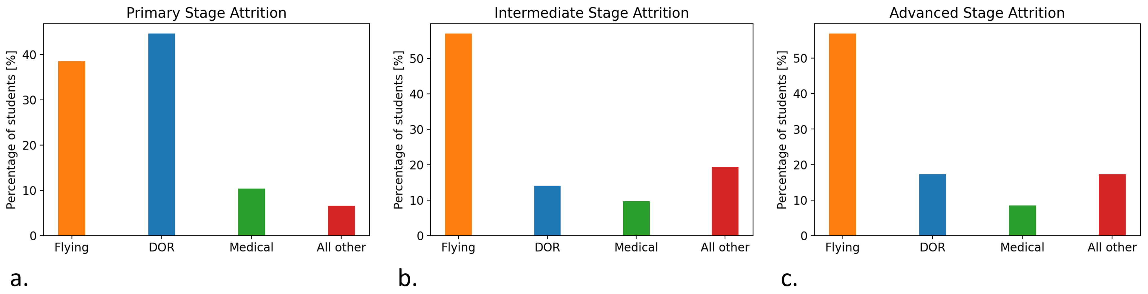
Attrition Risk and Aircraft Suitability Prediction in U.S. Navy Pilot Training Using Machine Learning
CNATRA’s six student navy aviator training pipelines
Naval student aviator attrition rates and associated cumulative attrition costs
Distribution of student attrition, by reason for attrition for training stages

Slide 14
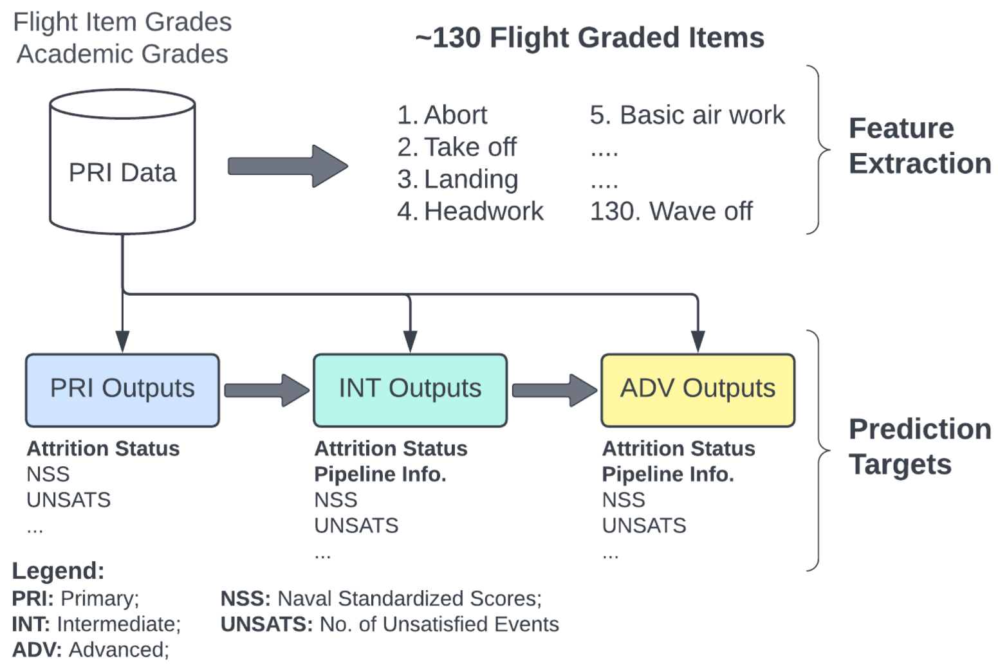
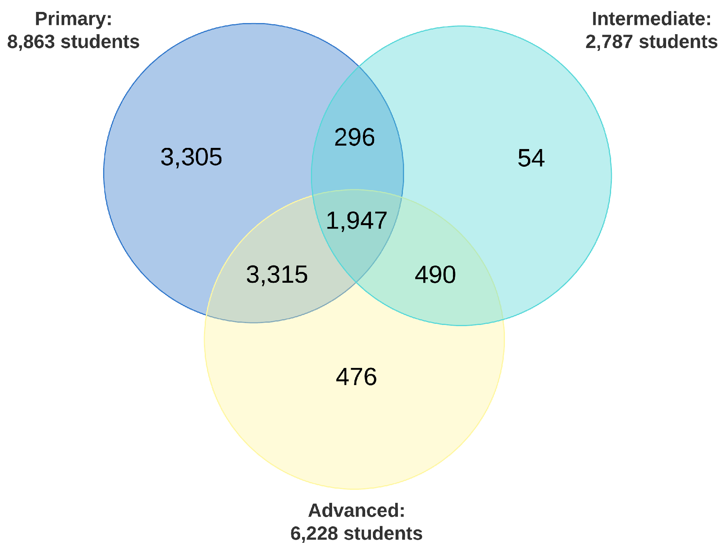
Attrition Risk and Aircraft Suitability Prediction in U.S. Navy Pilot Training Using Machine Learning
The dataset included flight grades, training outcome data, aircraft assignment, attrition reasons, etc.
Feature extraction was performed based on this data.
The main challenge was the lack of standardization and the high sparsity of the dataset.

Slide 15
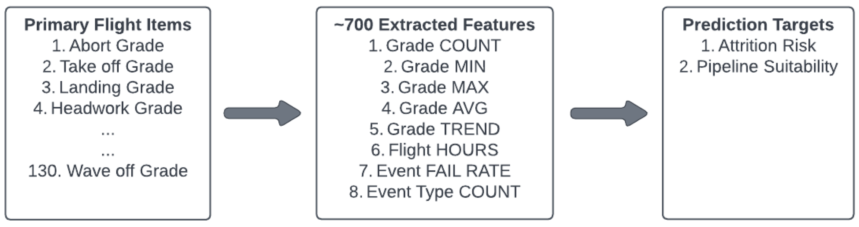
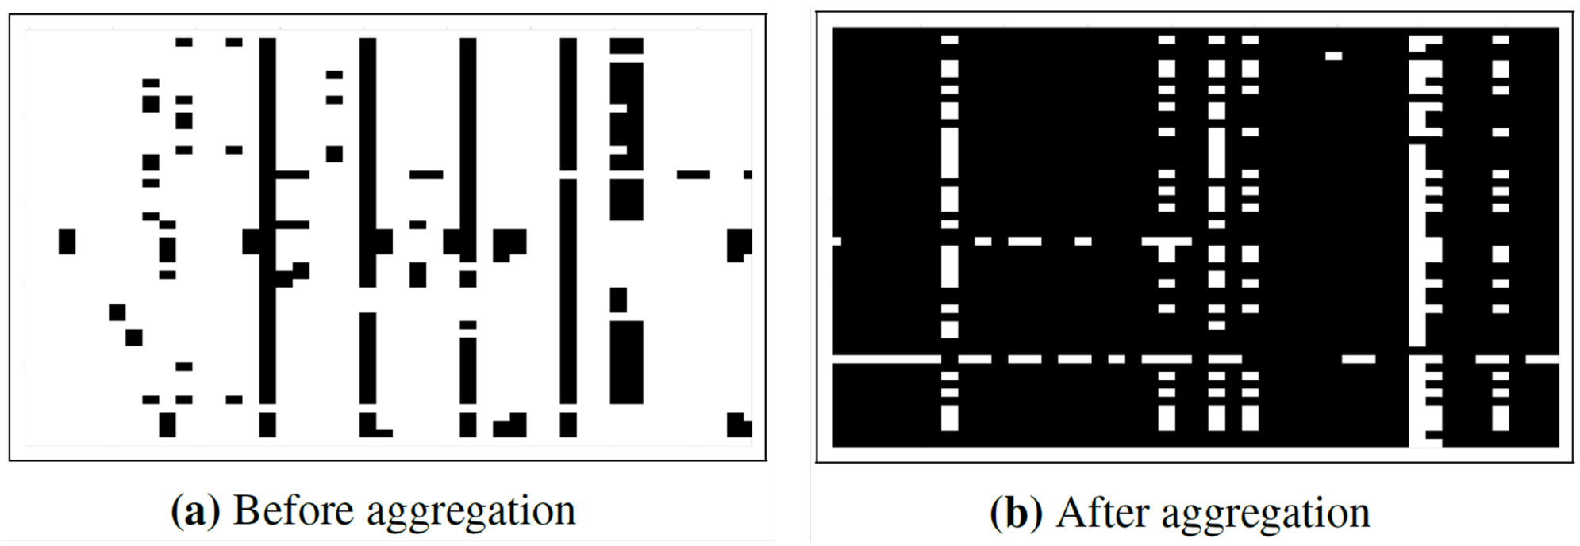
Attrition Risk and Aircraft Suitability Prediction in U.S. Navy Pilot Training Using Machine Learning
Data cleansing was performed removing inconsistencies, outliers and erroneous inputs
Due to 85% missing values in the dataset, feature aggregation was necessary to reconstruct meaningful and complete features.

Slide 16
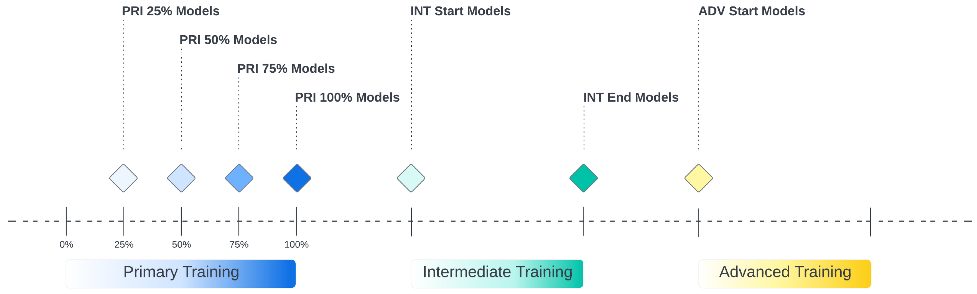
Attrition Risk and Aircraft Suitability Prediction in U.S. Navy Pilot Training Using Machine Learning
Binary supervised classification problem with probability scores (0-1) was used to assess attrition risk and aircraft suitability (pipeline recommendation).
Class imbalance challenge – attrition cases represent only 3% to 8% of the dataset.
Can be addressed using undersampling (reducing dominant class) and oversampling (ADASYN).
Tested models include logistic regression, support vector machines (SVM), K-nearest neighbors (k-NN), decision trees, random forests, gradient boosting, XGBoost, light gradient boosting machines, and multi-layer perceptrons (MLP)

Slide 17
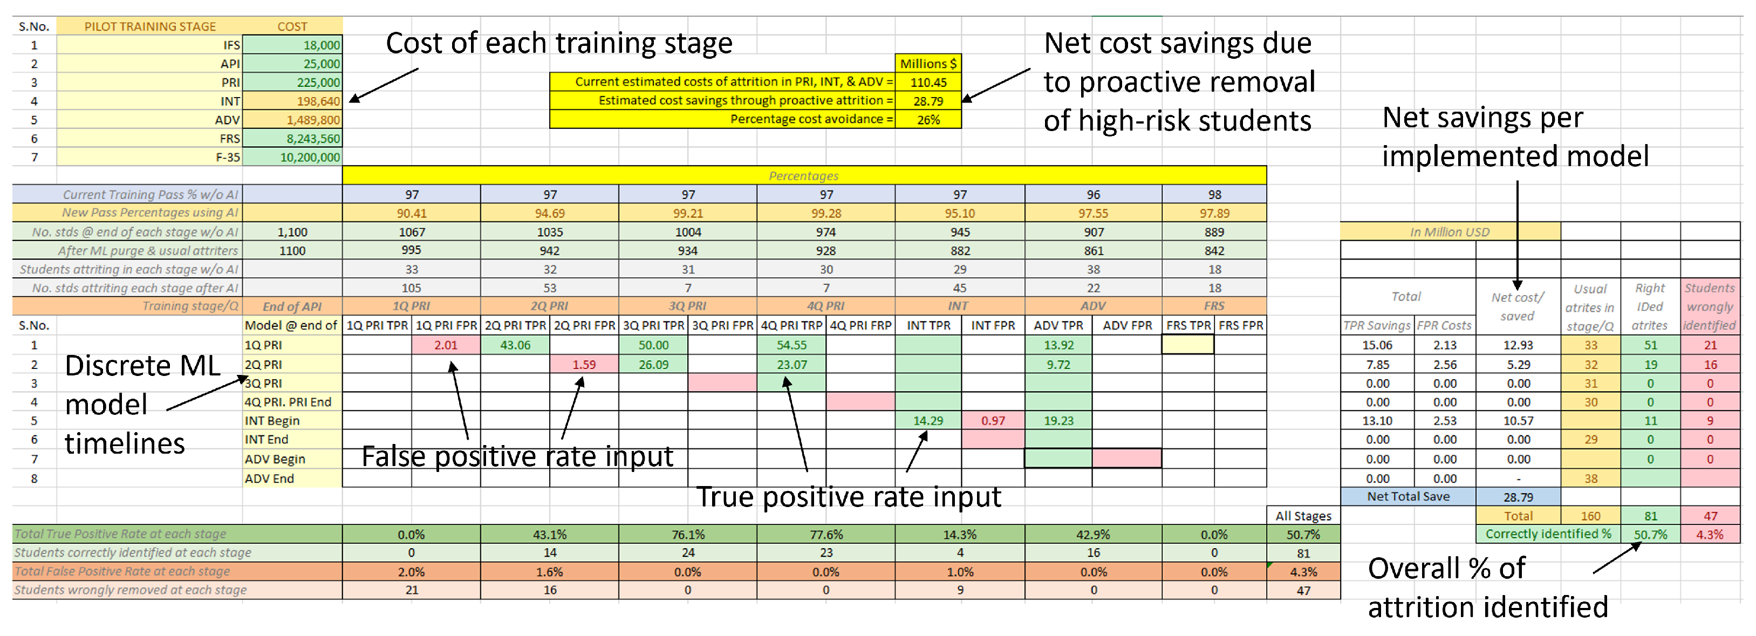
Attrition Risk and Aircraft Suitability Prediction in U.S. Navy Pilot Training Using Machine Learning
Cost savings and additional costs were calculated for each model’s predictions based on the estimated cost of training a student aviator in different stages of training

Slide 18
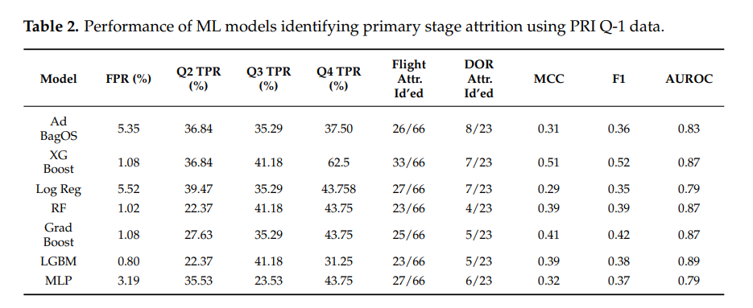
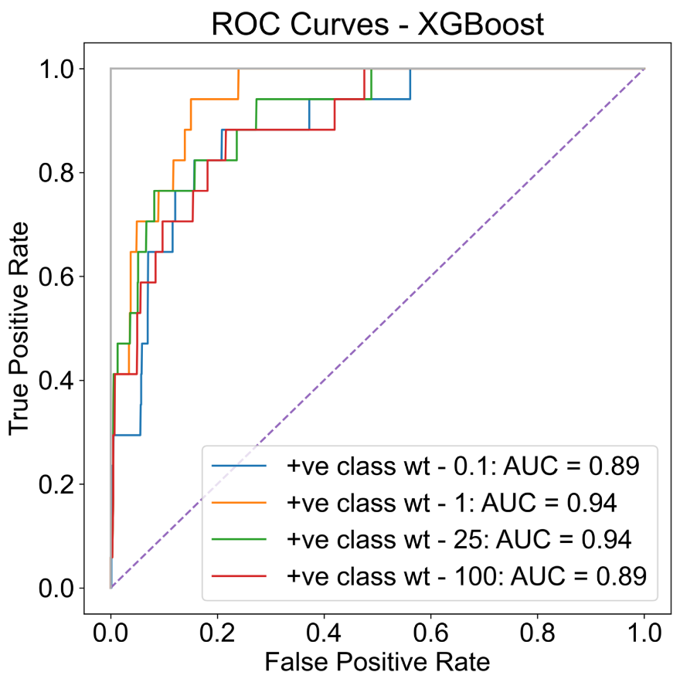
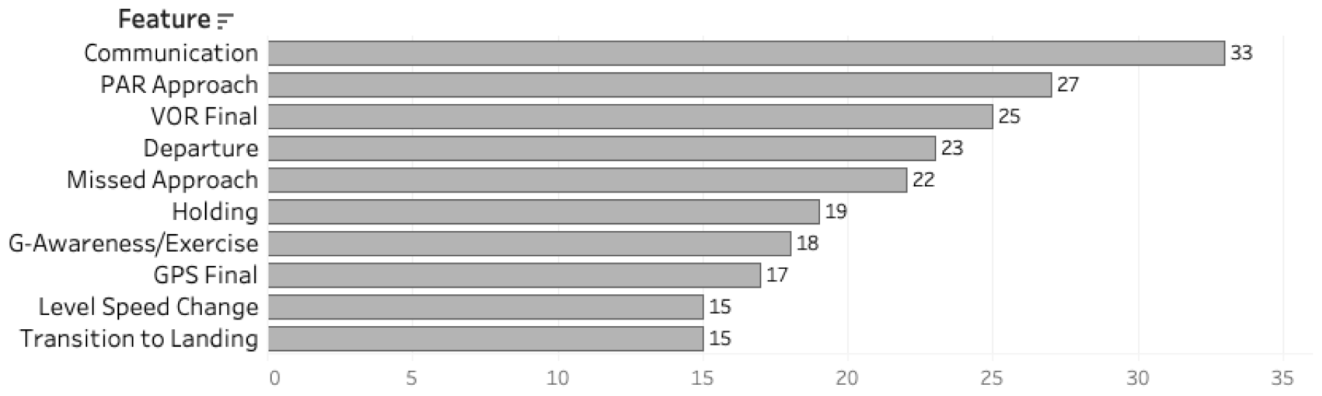
Attrition Risk and Aircraft Suitability Prediction in U.S. Navy Pilot Training Using Machine Learning

Slide 19
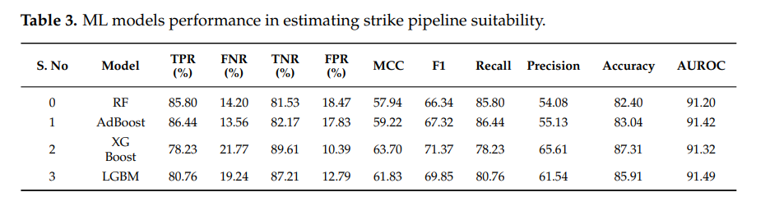
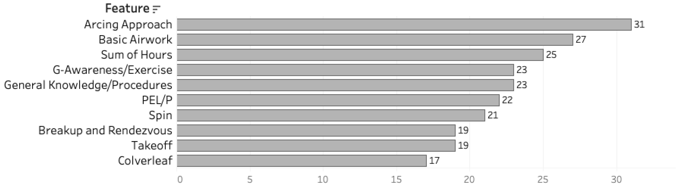
Attrition Risk and Aircraft Suitability Prediction in U.S. Navy Pilot Training Using Machine Learning

Slide 20
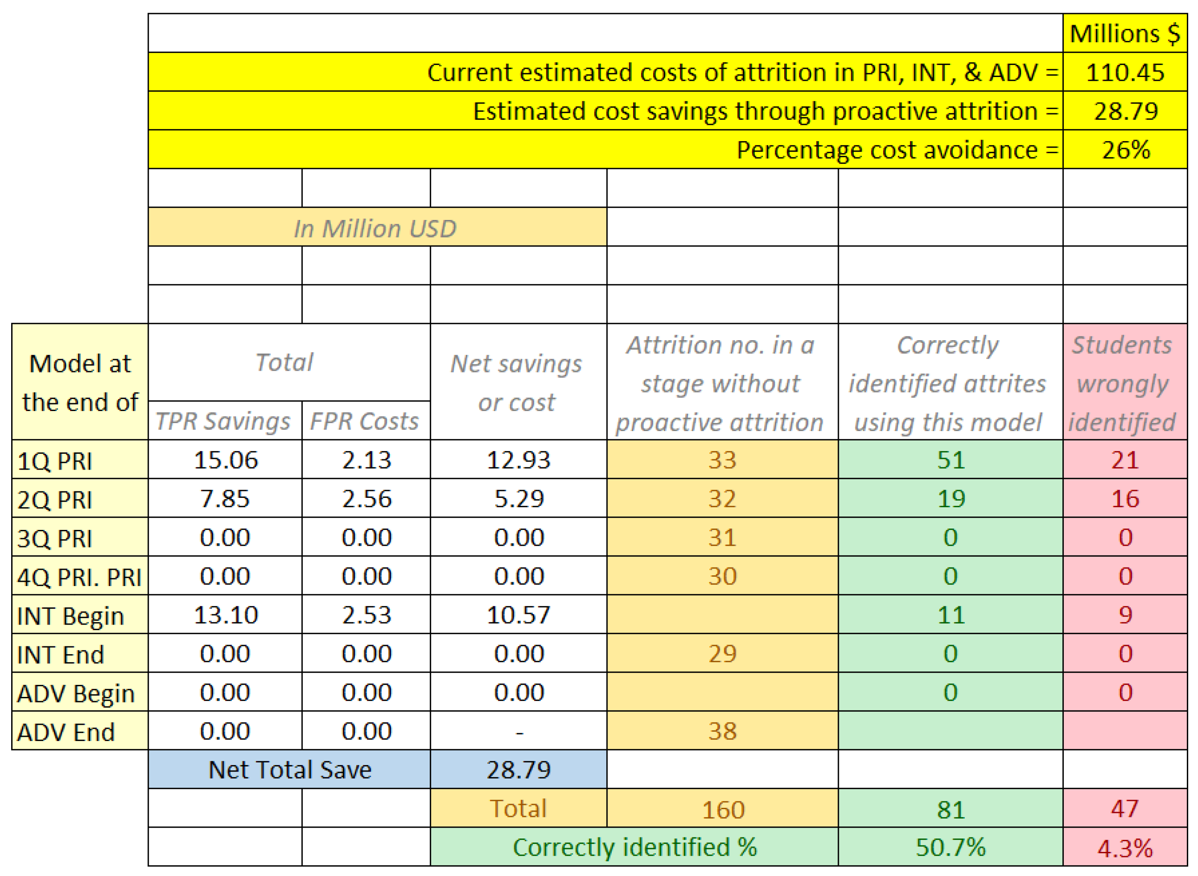
Attrition Risk and Aircraft Suitability Prediction in U.S. Navy Pilot Training Using Machine Learning

Slide 21
Classification of cognitive load based on neurophysiological features from functional near-infrared spectroscopy and electrocardiography signals on n-back task
Conclusion
The results demonstrate that a 26% reduction in attrition costs for the U.S. Navy could be achieved by proactively identifying and removing high-risk students before they progress further in training. This would lead to estimated savings of $29 million annually.
Alternatively, a more balanced approach could be taken, where only students with very high attrition risk are removed, while those with moderate risk receive additional training resources and support to improve their chances of success.
Opportunities for improvement: Enhancing accuracy through additional data integration (academic grades, pipeline preferences, slot availability), expanded training data (intermediate/advanced flight performance), hyperparameter optimization, feature selection, and exploring deep learning approaches.
While this study focuses on military pilot training, similar machine learning-based approaches could be applied in civilian aviation training, commercial flight schools, and other industries where high training costs and attrition rates impact operational efficiency.

Slide 22
Guthridge, R., Clinton-Lisel, V. (2023). Evaluating the Efficacy of Virtual Reality (VR) Training Devices for Pilot Training. Juornal of Aviation Technology and Engineering 12:2 (2023) 1-14. Institucije autora članka: University of North Dakota
Autor obrade članka:
Boris Boronjek
siječanj 2025.
Notes:
TBD Staviti slike itd.

Slide 23
Evaluating the Efficacy of Virtual Reality (VR) Training Devices for Pilot Training.
Abstract
Virtual reality (VR) technology is a quickly advancing field that has many documented benefits, including highly detailed environments, accuracy to the real world, and low cost of entry in the flight simulation market.
At the time of this study, VR technology has not been well tested or widely accepted in the aviation industry.
Data collected from 120 beginning-level instrument pilots performing a visual traffic pattern at an airport.
One-way ANOVA used to evaluate equivalence based on previous flight and VR experience.
Pre-test/post-test analysis: Comparison of training groups using a one-way ANOVA, followed by post-hoc Tukey HSD for multiple comparisons.
Key findings: VR training participants performed similarly to those in PC-based simulators, Both training groups outperformed the control group with no training, Students training in VR simulators reported better post-test performance and felt VR could be a viable training technology
Implication: Results support VR as a low-cost, high-value alternative to traditional flight simulators for training organizations.

Slide 24
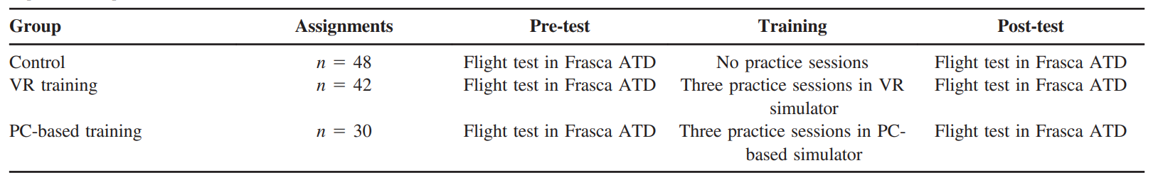
Evaluating the Efficacy of Virtual Reality (VR) Training Devices for Pilot Training.
Main Information regarding Research Methods
Mixed-Method approach: Combination of quantitative and qualitative data collection
Participans: 120 beginning-level instrument pilots
Tasks performed: Visual traffic pattern at an airport
Equivalence Testing: A one-way ANOVA was performed to compare the effect of four demographic variables -> airplane time, simulator time, VR experience, and VR familiarity
Quantitative Study: purpose of the quantitative study was to determine if VR flight simulators have a significant impact on a pilot’s performance versus PC-based flight simulators
Pre-test/Post-test variables: altitude, airspeed, and cross-track distance

Slide 25
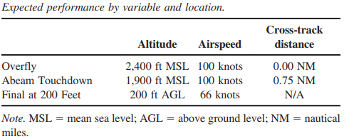
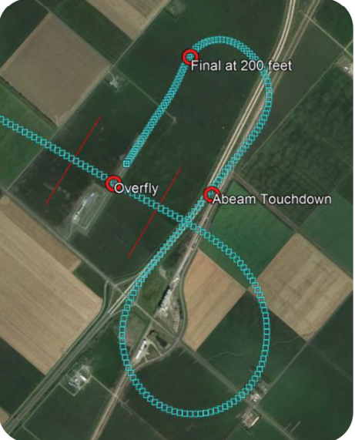
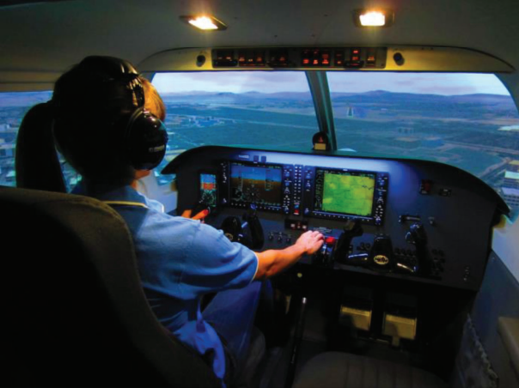
Evaluating the Efficacy of Virtual Reality (VR) Training Devices for Pilot Training.
Main Information regarding Research Methods

Slide 26
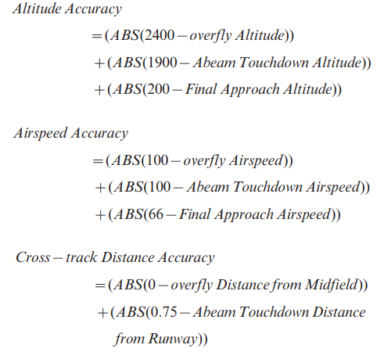
Evaluating the Efficacy of Virtual Reality (VR) Training Devices for Pilot Training.
Main Information regarding Research Methods
Accuracy Measures:
Survey:
The purpose of the survey instruments in this study is to understand the perceptions of VR technology and its acceptance and adoption by pilots into the flight training environment.
The pre-test survey asked for self-reported demographics of the participants’ training history prior to the study.
The post-test questionnaire was conducted immediately after the post-test flight and asked questions regarding the participants’ simulator training experience (PC-based or VR) and evaluated their perceptions on the acceptance and adoption of VR technology for pilot training.

Slide 27

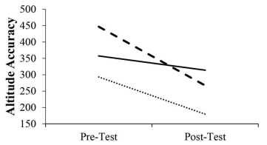
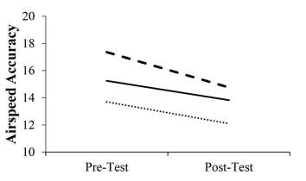
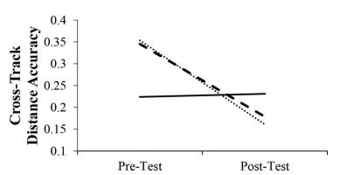
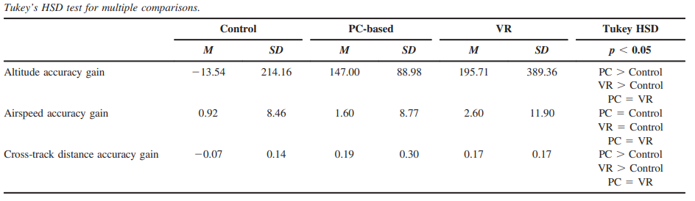
Evaluating the Efficacy of Virtual Reality (VR) Training Devices for Pilot Training.
Main Research Results
Statistically significant improvements in altitude accuracy gain and cross-track distance accuracy gain, but not in airspeed control for training groups who trained using PC-based simulators and VR

Slide 28
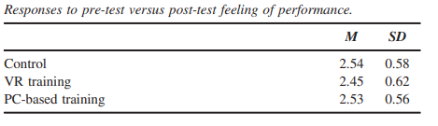
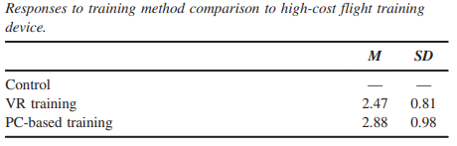
Evaluating the Efficacy of Virtual Reality (VR) Training Devices for Pilot Training.
Main Research Results
For the measure of pre-test versus post-test feeling of performance, students in all three groups felt like they did slightly better in the post-test than they did in the pre-test
For the measure of training comparison to a high-cost flight training device, participants who conducted training in both technologies (VR and PC-based) felt like they performed ‘‘about the same’’ as the high-cost training alternative
In the post-test survey, participants described the advantages and disadvantages of VR technology:
Advantages: ability to look around the aircraft by using the wings or other objects as reference points helps when flying in the simulator, VR is more readily available and cheaper for students to use, VR is available for home use at a reasonable cost which can help with preparing for lessons at home prior to flying the real aircraft.
Disadvantages: VR does not allow you to interact with the aircraft instruments and equipment, you cannot see or feel the flight controls which makes it hard to practice tasks like checklist usage, VR headset didn’t fit well and was sometimes blurry when looking through glasses

Slide 29
Evaluating the Efficacy of Virtual Reality (VR) Training Devices for Pilot Training.
Conclusion
PC-based training and VR training significantly increase a pilot’s performance on the variables of altitude accuracy and cross-track distance accuracy. For the variable of airspeed, there was no significant effect that training improved a pilot’s ability to control that variable
Students believe they perform „about the same” in VR as they do in high-cost flight simulators and it can help them improve their performance in the real airplane
VR is a viable alternative to high-cost flight simulators
There is some room for improvement with VR technology and ergonomics, but students would largely accept virtual reality as a suitable flight training device
This is a substantial improvement that will allow more instructors to utilize the benefits of flight simulators when training student pilots, due to removing the high-cost barrier to entry

